Slide 1
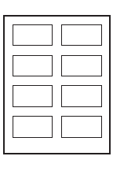
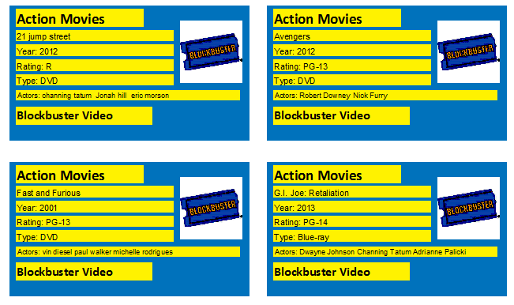
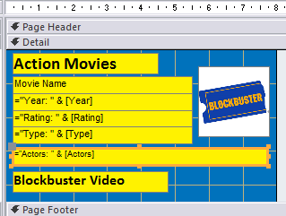
Produce labels from all the data which: Are arranged in two columns Show only the records where the genre is Action - Remember to create the query Sort the Movies into Ascending order Show only the fields Movie Name, Year, Rating, Type and Actors each on a separate line Display the field name as well as the data apart from the Movie Name Field. Resize the font in the actors field to 7. Include in the heading – Action Movies - at the top of each label (Size 14, Bold and Black) Include in the footer - Blockbuster Video at the bottom of each label. (Size 12, Bold and Black) The Blockbuster Logo should appear on each label to right of the text. Format the background to Blue. Format the colour of the header, footer and fields to Yellow Preview in Print Preview before you print
Example Label:

